Slide 1
Data Coordinators Meeting
December 2, 2021

Slide 2
Agenda
State Reporting
21-22 BEDS Day Reporting
PD Reporting
Jan Reporting
SED Testing Updates
3-8 Testing
January Regents
Level 1 Updates
Notes:
Bridget

Slide 3
State Reporting

Slide 4
2021-2022 Student BEDS Day
BEDS Day Enrollment Extract (SIRS 312, 313, 314, 316, 319, 350)
Enrollment by grade, district of residence, district Pre-K, and supplemental enrollment counts are collected for calculating preliminary State Aid allocations
BEDS Day Free and Reduced Priced Lunch Extract (SIRS-323 and SIRS-327)
Even though all students can get a free lunch all year, only students who meet the eligibility requirements get the FRPL program service
Must be reported with 5817 – Free Lunch Program or 5806 – Reduced-Price Lunch Program
All must have 0198 – Poverty-from low-income family
Data due Thursday, January 6
Notes:
Laurie

Slide 5
2021-2022 UPK Data
AS OF TODAY: UPK Counts will be collected using BEDS Day Counts
Counts of UPK students are collected for calculating UPK grant funding
SIRS-316 BEDS Day Enrollment Verification Report for District PreK
Data due Thursday, January 6
POSSIBLE CHANGES: More to come
There may be changes to how UPK counts are collected for 21-22
Look for a memo from the Office of Early Learning
Notes:
Laurie

Slide 6
What Pre-K Program Service Code to Use?
Description | Grade Level | Pre-K Program Code |  | UPK Setting
 |  | 902 (Universal PreK) | 990 ("Other PreK)
1.) Any child whose Pre-K placement is funded solely by the allocational Universal Pre-K (UPK) grant | PKF of PKH whichever is appropriate | X |  | X
2.) Child whose half-day UPK placement has been converted to full-day using Statewide Universal Full-day Prekindergarten grant (SUFDPK) (For example, a child whose placement is funded for the first half-day by the allocational UPK program and the second half of the day by the SUFDPK program.) | PKF | X |  | X
3.) New full-day placements funded by Statewide Universal Full-day Prekindergarten (SUFDPK) | PKF |  | X
Notes:
Laurie

Slide 7
New SIRS Reports
SIRS-336 Annual Digital Equity Survey Report
Team Content > L2RPT Reports – SEDDAS > Annual Outcomes
Displays data by location
Shows number of students missing survey
Excludes students enrolled full time in an Out Of District Placement
SIRS-750 Student Profile Report
Team Content > L2RPT Reports – SEDDAS > Student Profile
Included in this report is a student’s
Enrollment history in NYS
Program Service history
Assessment history
Courses, Classes and Grades history
Yearly Attendance History
Notes:
Laurie

Slide 8
Questions?
For the latest State Reporting information, please read the MAARS Weekly Digest sent out each Friday afternoon!
Notes:
Laurie

Slide 9
Level 0

Slide 10
Level 0 Updates
Version 16.01
Auto time out
Increased to 15 minutes
Help Menu

Slide 11
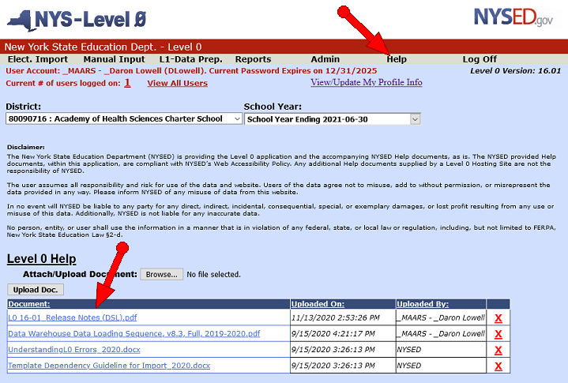
Level 0 16.00
Help Menu
Notes:
Populated documents form NYSED and MAARS
Will support links in a future release
The Disclaimer text will be shown separately by clicking on the “Disclaimer” link in the footer

Slide 12
Questions?
Notes:
Laurie

Slide 13
PD Reporting

Slide 14
PD BEDS Reporting
The October Snapshot Reporting:
Requires Certification of VR’s 1-6, and VR 8
Certification in the PD Data System is DUE January 10, 2022
Entities that need to certify VR1-6, VR8 in the PD Data System: Public, Special Act, Article 81, State Agencies, and State Operated schools/districts
SPED data to upload for October VR reports:
Type of Disability
October Snapshot - Students with an IEP in effect on BEDS day, and with programs or related services that span BEDS day 10/6/21
Notes:
DDC’s should be uploading the October Snapshot so SPED directors can review their data in the PD Data System.
Work with SPED department to update information if needed.

Slide 15
PD BEDS Reporting
REVIEW VR 7 (Preschool) and VR 9 (School Age)
Public, BOCES, Charter, Special Act, Article 81, Approved Private, and State Supported schools/districts need to review the VR 7 and VR 9 data in the PD Data System
NOTE:
VR 7 and VR 9 are Provider reports (students receiving services in your program), which are included in the October Snapshot reporting period, but do not get certified.
This data populates from enrollment data uploaded by the DOR, and needs to be reviewed by your SPED department for accuracy.
The data in the report should be consistent with the data provided to school districts on the SEDCAR 1 forms (due in late November) used to request a vendor per-pupil funding amount of IDEA funds.
Notes:
VR 7 and VR 9 are Reference reports used to confirm the enrollment of SWD in your program who are receiving Special education services. VR 7 = Preschool, VR 9 = School Age. Each reports includes your students, and any students from outside your district who were placed in your program.
SPED department needs to review, but they may need to contact you about enrollment changes.
Directions: Please review the number of SWD in your program who are provided special education services, against the numbers from each school district as reported in the PD Data System. If you are seeing students who are not in your program, contact the special education office of each school district to resolve the enrollment discrepancy, as the district will need to resubmit their district enrollment files with the necessary corrections to Level 0.
Important for SPED departments to review early, due to SEDCAR 1 forms submission deadline
Please note that BOCES and Charters also need to review this data

Slide 16
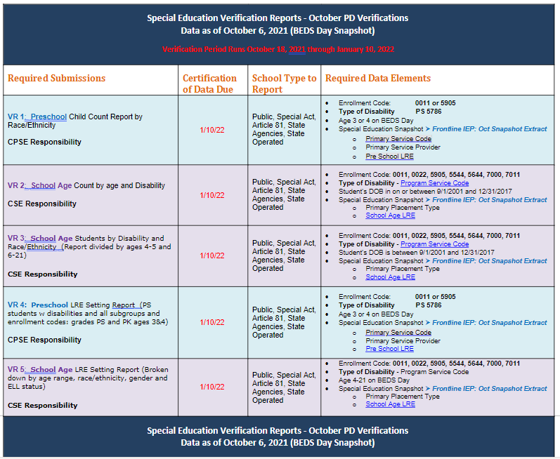
Click to access this VR 1-9 reporting table
Notes:
Reference Handout

Slide 17
Update on Home Schooled SWD Reporting:
Notes:
5905 enrollments for home schooled students who are not receiving services, or are registered for assessments, can be deleted from Level 0.

Slide 18
PD Reporting: Verification
Tips on Verifying your BEDS Day/October Snapshot reporting for VR’s 1-9
Entry/Exit Dates
Transfer students – get a report from SMS to confirm start dates of Transfer students
Confirm entry enrollment date is the same as the start of service date on the IEP
Confirm exit enrollment dates and IEP exit dates of any students who left around BEDS day
Decision Status
‘Classified No Services’ – this must be the Decision/Status for students who are waiting to be placed with a provider. Should be excluded from Snapshot if they were not receiving services on BEDS day.
Notes:
Share with SPED department as they verify the data for VR Reporting – Areas to check that can cause inaccurate inclusion or exclusion

Slide 19
PD Reporting: MAARS Contacts for Data Reporting
PD Reporting and Frontline IEP:
Kerri Baxendell 349-9077 kbaxende@bocesmaars.org
Patty Zeiner 349-9053 pzeiner@bocesmaars.org
Level 0:
Daron Lowell 349-9064 dlowell@bocesmaars.org
SIRS Data:
Laurie Hazard 349-9051 lhazard@bocesmaars.org
SMS Specifics: Contact your SMS Liaison
Notes:
Call or email if you need help!

Slide 20
SED Testing Updates

Slide 21
3-8 Testing – Keep your ELL department folks up to date
Friendly reminder… any information you may receive concerning NYSESLAT, NYSITEL, English Language Learners data… etc., please make sure your ELL department folks are receiving this information. For example, how to return materials, packing of materials, deadlines … etc.

Slide 22
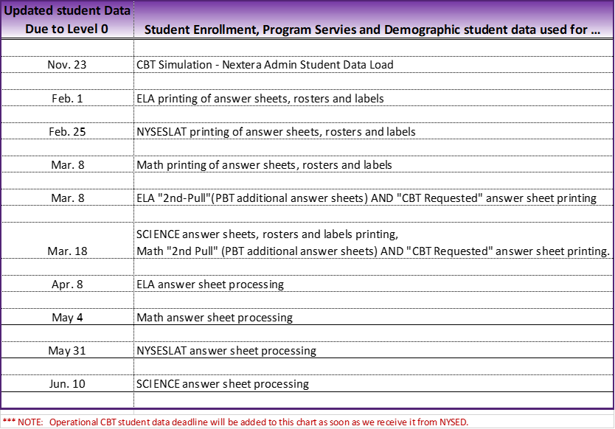
3-8 Testing – Student Data Level 0 Deadlines for Answer Sheet Printing and Processing

Slide 23
3-8 Testing – Answer Sheets, Rosters & Labels MAARS shipping schedule (tentative)

Slide 24
3-8 Testing – Premier (Scoring) Printed Student Bar-code Labels
(schools using Premier-“online” scoring to score their written part of assessments)
Use only Premier bar-code student labels on test booklets (do NOT use MAARS labels)
Follow Premier instructions/directions for placement of these bar-code student labels on student test booklet(s)

Slide 25
3-8 Testing - General information to keep in mind for Premier Scoring
Premier offers 3 types of Scoring services…
Online (student paper tests only) (also refered to as "electronic") – which requires a student bar-code label on test booklets, test booklets scanned by Premier and CRs scored via a system they manage. A student CR score file is sent to MAARS to merge with the student’s scanned answer sheet data and then on to the data warehouse (NYSED) for final scores. (NO Answer Sheets are sent Premier)
Computer based (offered to CBT schools ONLY) – where Premier coordinates/manages the scoring using ScorePoint (Questar’s Scoring system). CR scores go directly to Questar to merge with the students remaining part of the test, final scores created and reported to NYSED.
Paper (student paper tests only) – where both the test booklet and answer sheets go to Premier, and the CR scores are recorded on the answer sheets, processed by MAARS, sent to the data warehouse (NYSED) for final scores.
***CR = Constructed Responses

Slide 26
3-8 Testing - General information to keep in mind for Premier Scoring
Follow Premier instructions/directions for packing test booklets for Online & Paper Premier scoring services.
When do you send the student’s answer sheets to Premier with the booklet being scored? Answer: ONLY when using the paper scoring service.
Do NOT put answer sheets inside test booklets being scored by Premier using online scoring.
Premier online scoring answer sheets should be packed up separately following MAARS Packing directions.
Side Note: If using any other scoring vender, your school should carefully follow that vendor’s instructions/directions, NOT Premier’s directions.
It is the responsibility of each school/district to make sure answer sheets are returned to MAARS by deadline for processing.

Slide 27
3-8 Testing – Your CBT Resources
Weekly Digest – Emailed every Friday by MAARS
CBTsupport Webpage – https://cbtsupport.nysed.gov/
School Administrators Manual (SAMs) …
http://www.nysed.gov/state-assessment/grades-3-8-ela-and-math-test-manuals
MAARS – Mari-Ellen Maloney 349-9025 (mmaloney@bocesmaars.org)

Slide 28
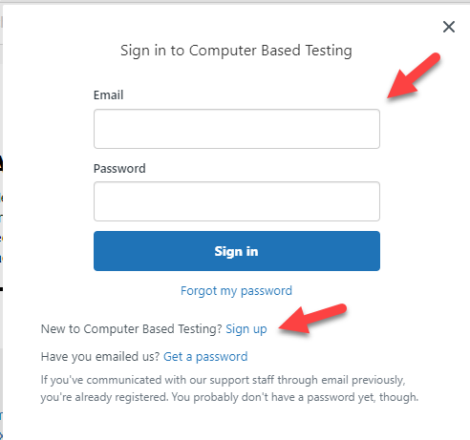
3-8 Testing – Computer Based Testing (CBT): How to Set Yourself Up to Automatically Receive Updates and New Postings in CBTsupport
On the CBTsupport website page
(top right) click on [Sign in] button.
Login if you have one. If you do not have a login,
click “Sign up” next to “New to Computer Based Testing”
below the sign-in boxes.
For each topic section, click on the title (ex: Announcements… etc.)
Click on the down arrow next to “Follow”, then click on “New articles and comments”
This will set you up so that you will receive notifications on any new articles posted or comments.

Slide 29
3-8 Testing – Simulation & Operational CBT – Student Moves within Nextera Admin
District level coordinators (DTC) can move students from one building to another building within Nextera Admin. However, they cannot move a student from another district or school outside their district.
If you have a student that needs to be moved from outside your school/district to your school/district, contact Mari-Ellen Maloney. (back-up Caroline Shaw)
When requesting a student move to us please include student name and NYSSIS ID.
The NYSSIS ID works better than the Local ID when searching for the student in Nextera.
We will create a template for folks to securely post these requests. Possible via Google Form?

Slide 30
3-8 Testing – Operational CBT - The Importance of Accurate Tested/Not Tested Codes in Nextera Admin
Make sure schools …
review all tested/not tested codes entered in Nextera Admin for accuracy.
Remove session absent when they have completed that session of the test.
Students that have an RNT of absent and have answers on their tests may not get a final score.
The Testing Status Details should be exported, from Nextera, for review on the last day of testing.
CBTsupport Good Article and PPT: Documentation: How to Set Not Tested Codes
There is a Power Point “Not Tested Codes 2020.pdf” listed at the bottom of the above CBTsupport article that will help you run and export the Test Status Detail report

Slide 32
JANUARY 2022 REGENTS
January 2022 Regents:
Pertinent information (including the highlights below) have been updated in the MAARS website at January 2022 (monroe2boces.org).
M.A.A.R.S. Pre-printed answer sheets:
MAARS order form for preprinted answer sheets due 12/17: MAARS January 2022 Regents Preprinted Answer Sheet Order Form
Files of student demographic information is due 12/17 to MAARS through the secure Monroe FTP site. Please do not email files of student information!
Any needed additional walk-in files are due 1/17 and will continue to be accepted by MAARS up to exam time. Last minute answer sheets will be printed to a PDF file and sent to the school for printing.
Do not make copies of pre-printed or blank answer sheets for students to use.
MAARS will start preprinting answer sheets in the last week of December. They will be shipped to Districts/BOCES starting on January 3. We will notify the other schools when their answer sheets are ready to be picked up at MAARS.
Reminder: The Physical Setting/Physics exam, (course code: 03151) offered in January, is a Restricted Test which means each test is numbered and sealed with an answer sheet in its own envelope. You will NOT receive preprinted answer sheets from MAARS for this exam.

Slide 33
Level 1 Updates

Slide 34
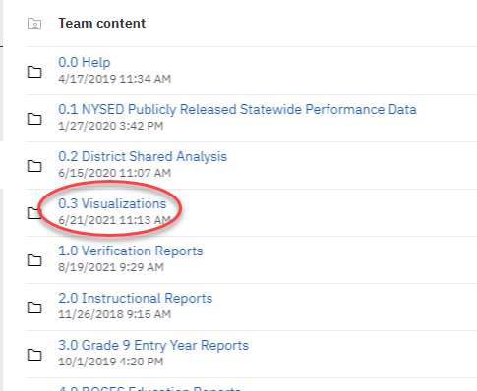
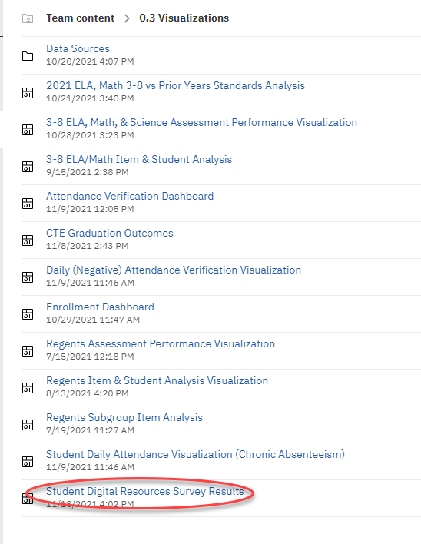
A New Visualization: Student Digital Resources Survey Results

Slide 35
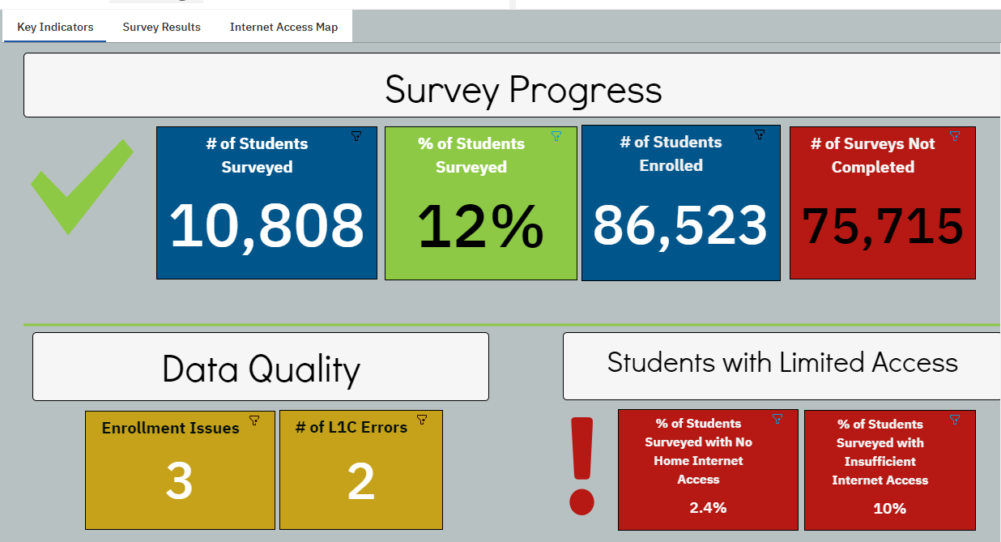
Key Indicators

Slide 36
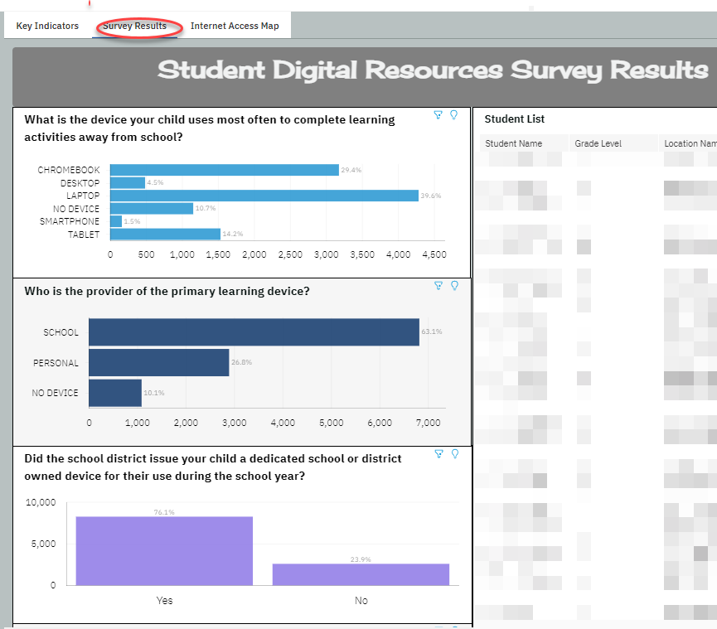

Slide 37
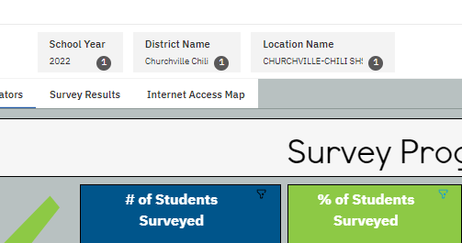
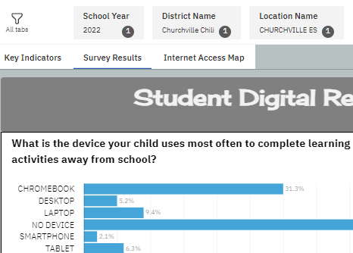
Can Filter by Location

Slide 38
District Data Coordinator Training Series

Slide 39
DDC Training Sessions
The "District Data Coordinator Training Series" are several sessions giving a birds-eye view of various areas of what a District Data Coordinator needs to know, and what to be aware of.
The focus of the "DDC Training Series" is for those who are new to the DDC role, and as a review for those currently in this role.
https://www.monroe2boces.org/DDC-Training04_ReportOverview.aspx

Slide 40
DDC Training Sessions
Please mark your calendar for the following dates
As we get closer to each session, I will send out registration forms and further details.
DDC Training session | Date | Time
DDC Training #4 Session - January Regents & BEDS day | 12/14/2021 | 1-3 PM
DDC Training #5 Session - PS Deep Dive, 3-8 Testing | 3/15/2022 | 9-11 AM
DDC Training #6 Session - EOY Prep & June Regents | 5/24/2022 | 1-3 PM

Slide 41
Questions?
Next Meeting: March 8th 9:00 am
Notes:
Bridget

